Slide 1

Credit Card Fraud Detection
Prepared By:
Pooja Dahal (NCCSCSIT271)
Priyanka Pathak (NCCSCSIT274)
Tenzin Lhamo (NCCSCSIT294)

Slide 2
Acknowledgement
We would like to thank NCCS College for providing us this opportunity to
showcase our skills.

Slide 3
Table of Content
Introduction
Objectives
System Flow diagram
Work completed
Work to be done
References

Slide 4
Introduction
Credit Card Fraud can be defined as a person uses someone else’s credit card for personal reasons.
The owner and the card issuing authorities are unaware of the fact that the card is being used.

Slide 5
Objectives
To implement an algorithm for determining whether the transactions are fraudulent or non Fraudulent.

Slide 6
System Flow
Preprocessing
Login or Register
Feature Extraction
Predict
Train the Model
With logistic regression and Decision Classifier
User
Fig: Flow of the system

Slide 7
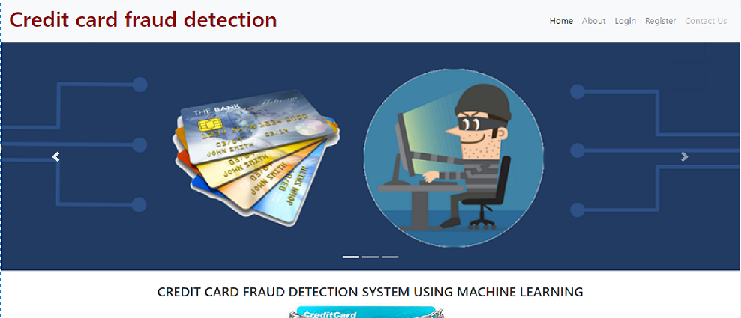
Work Completed
Screen design of the project

Slide 8
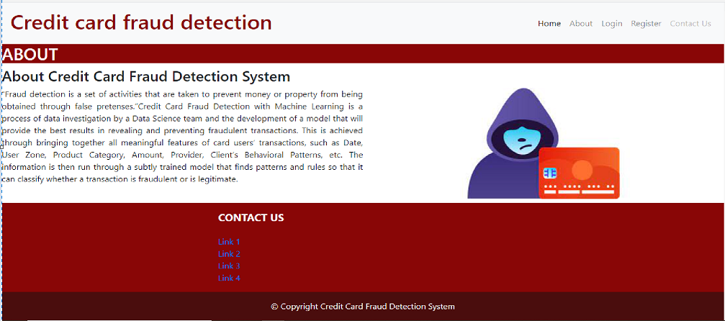
Work Completed(cont..)

Slide 9
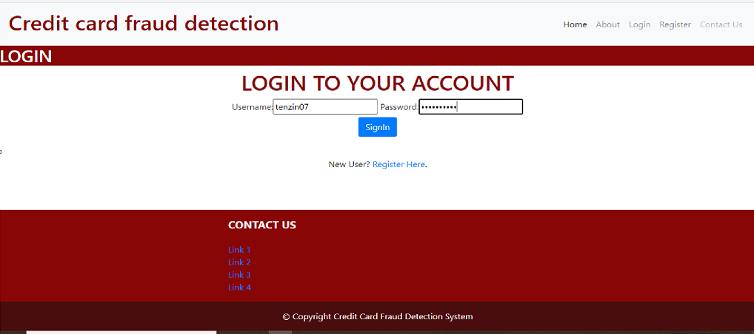
Work Completed(cont..)

Slide 10
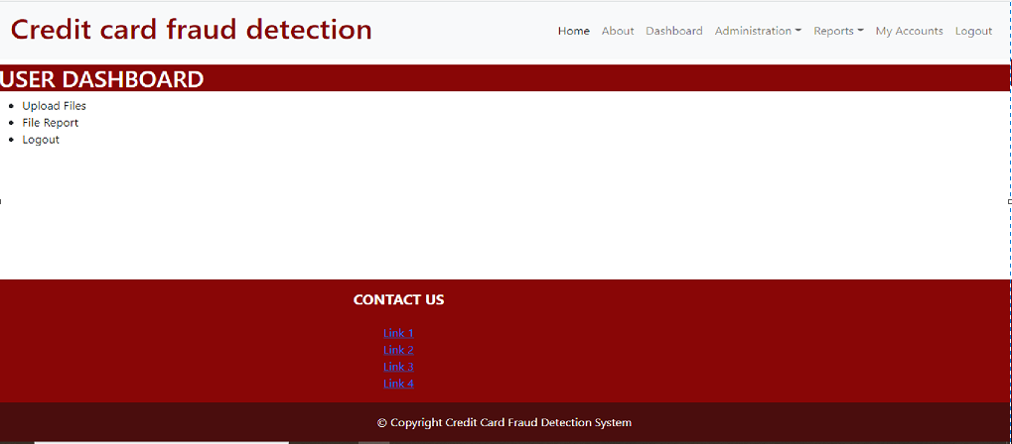
Work Completed(cont..)

Slide 11
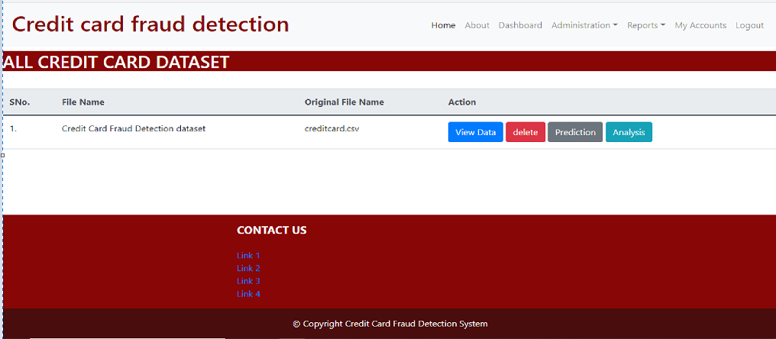
Work Completed(cont..)

Slide 12
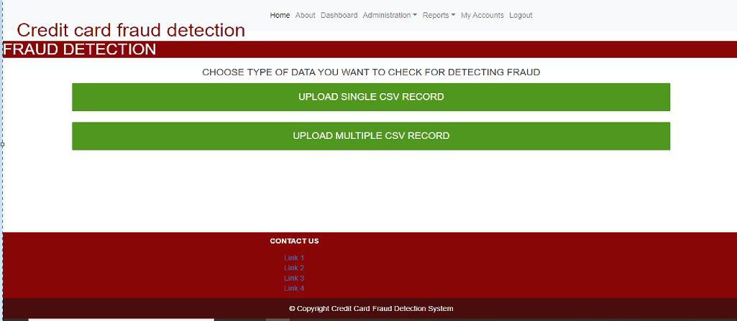
Work Completed(cont..)

Slide 13
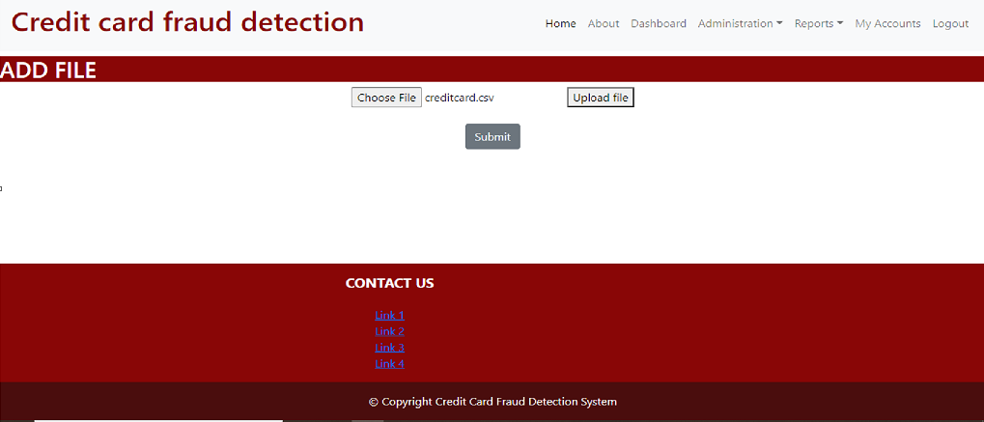
Work Completed(cont..)

Slide 14
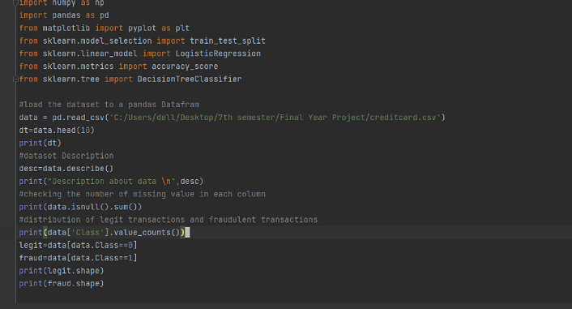
Work Completed(cont..)
Source Code

Slide 15
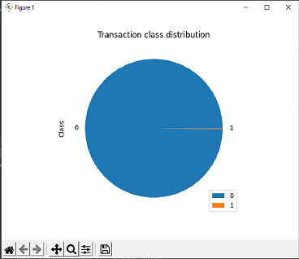
Work Completed(cont..)
Output

Slide 16
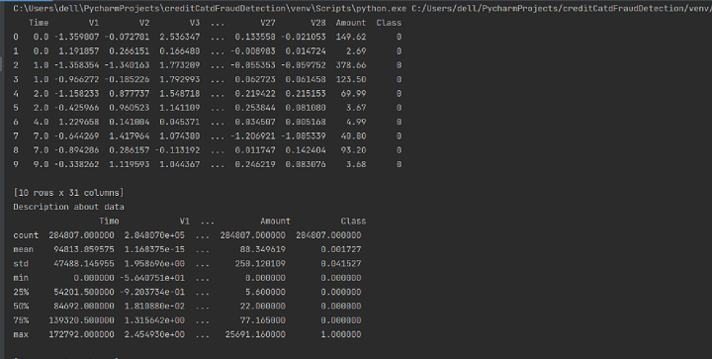
Work Completed(cont..)
Output

Slide 17

Work Completed(cont..)
Output

Slide 18
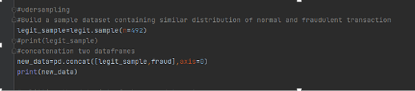
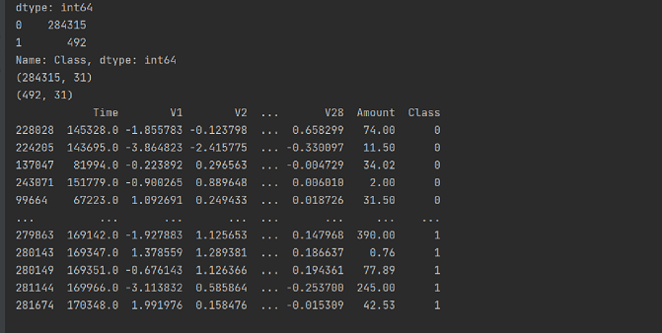
Work Completed(cont..)
Source code
Output

Slide 19
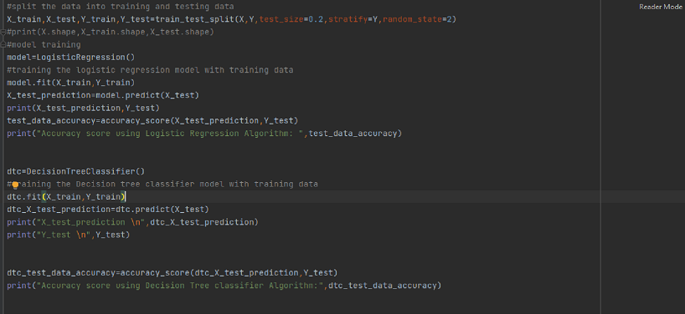
Work Completed(cont..)
Source code

Slide 20
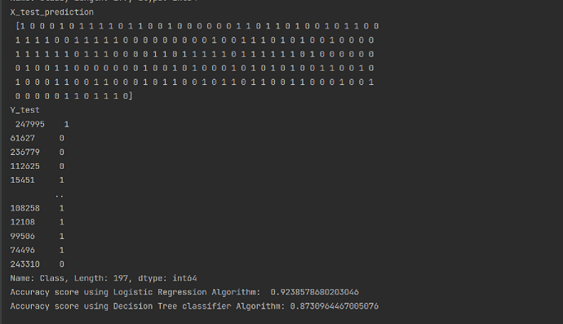
Work Completed(cont..)
Output

Slide 21
Work to be completed
Registered data need to be added in database.
View data , delete and analysis part are not completed as python code has not been web based yet.
In prediction we are able to upload the file however the output is not yet shown.
To predict a single transaction is fraud or genuine is left
We are still researching to make the python code web based and to make the webpage more user friendly.

Slide 22
References
[1] S. A. Padvekar, P. M. Kangane, and K. V. Jadhav, “Credit Card Fraud Detection System,” Int. J. Eng. Comput. Sci., vol. 4, pp. 24–31, 2016, doi: 10.18535/ijecs/v5i4.22.
[2] S. Bansal, “IJARCET VOL 3 ISSUE Survey Paper on Credit Card Fraud Detection,” vol. 3.
[3] W. F. Yu and N. Wang, “Research on credit card fraud detection model based on distance sum,” IJCAI Int. Jt. Conf. Artif. Intell., pp. 353–356, 2009, doi: 10.1109/JCAI.2009.146.
[4] S P Maniraj, Aditya Saini, Shadab Ahmed, and Swarna Deep Sarkar, “Credit Card Fraud Detection using Machine Learning and Data Science,” Int. J. Eng. Res., vol. 08, no. 09, pp. 110–115, 2019, doi: 10.17577/ijertv8is090031.
[5] S. K. K. Asha RB, "Credit card fraud detection using artificial neural network," Global Transitions Proceedings, 2021

Slide 23
THANK YOU

